Slide 1
Managing and Navigating WinRMS Session 4: Setting up Accounts, Expense Transfers and Split Account Transactions
Erin Olson, Supervisory Budget Analyst – St. Louis
Kari Points, Director Research Operations Iowa City
Antonio Laracuente, Director Field Operations - ORD
June 23, 2021

Slide 2
Objectives
4 Sessions
TDAs – Allocations and Distributions including Prior Year – June 15
Salary Management - June 16
How to Manage the Noise in WinRMS – June 22
Setting up Accounts, Expense Transfers and Split Account Transactions – June 23

Slide 3
Presenters
Antonio Laracuente – Director, Field Operations
Kari Points – Director Research Operations – Iowa City
Tabitha Randall – Supervisory Budget Analyst – Salt Lake City
Jamece Petteway – Supervisory Budget Analyst – Durham
Travis Peake – Supervisory Budget Analyst – Portland
Erin Olson – Supervisory Budget Analyst – St. Louis

Slide 4
Disclaimers and Thoughts
These are ideas that we are presenting to make WinRMS useful. If you have better ideas or ways to manage, please send those to any of us.
There are many ways to attack WinRMS however the presentations are based on the long term experiences of the users
Do not hesitate to contact any of us to help out
If you do not have WinRMS and would like it, please contact Kashif Iqbal or myself
It takes a few months to get WinRMS going at a station
The larger the station the more effective WinRMS is since it manages many accounts and control points
It takes daily management to make this work
You need to utilize other tools such as VSSC and IFCAP (VISTA) to reconcile and manage

Slide 5
Rules of Engagement
Setting up accounts is critical to managing the program
Will show you some upcoming updates
IPAs – Various ways. Whichever you do it you should balance the obligation
Cores and per diems are similar in approaches
Expense transfer is NOT like expense transfer in fiscal
The expense transfer stays within the FCP initiated

Slide 6
Setting up Accounts
General rules
In the old days, it was common to use the CC last number to setup the accounts
Ex. 8103 - 3 series , 8124 – 24 series, 8134 – 34 series
Try to split up by program
Multiple accounts can be used to support one project
However try not to use one account to support multiple projects
With the advent of service ID and expense reporting, may want to consider setting up new accounts for new service IDs

Slide 7
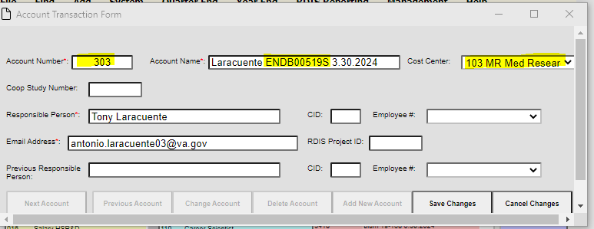
Setting up Account
Add > Add Account > add new account

Slide 8
Account in Rehab

Slide 9
Update to Account Screen coming soon

Slide 10
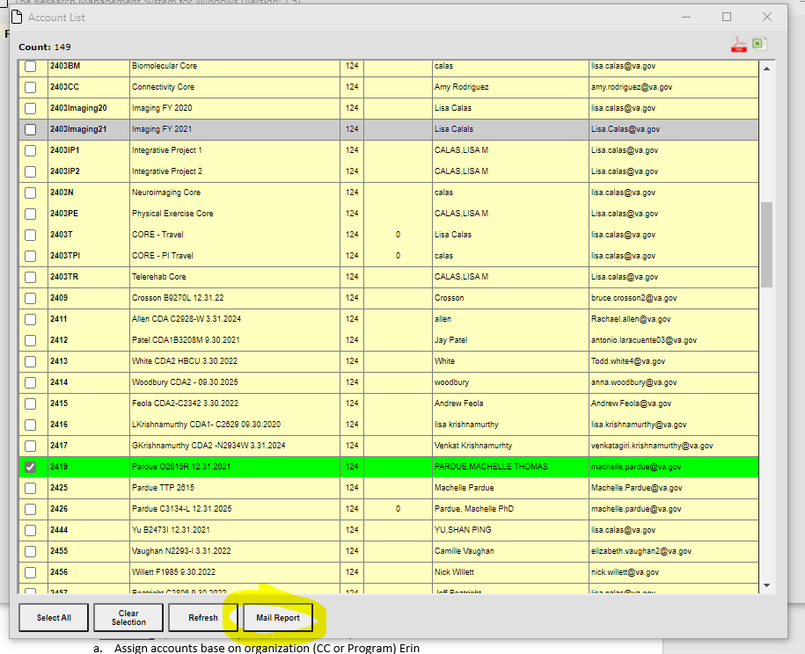
Emailing Accounts
Email function under Accounts
Select accounts to email or select all

Slide 11
Emailing – Edit and Send

Slide 12
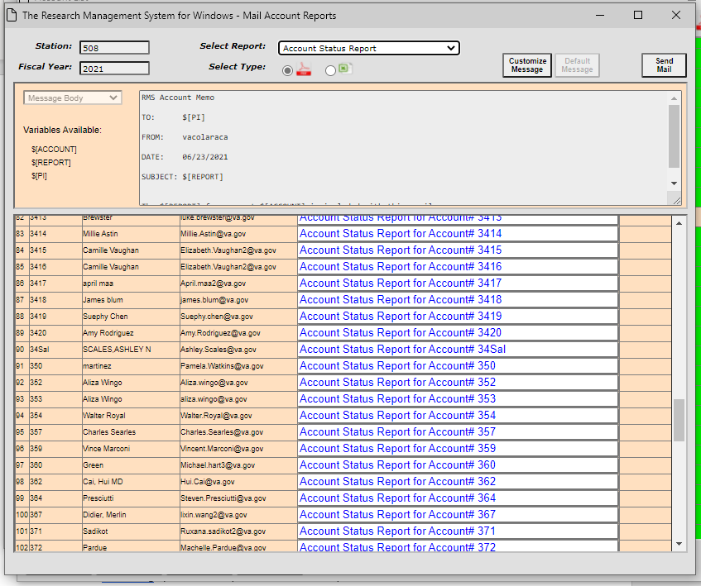
Batch Mail

Slide 13
IPAs
Managing research dollars varies by station, keep in mind:
You may establish IPA Purchase Orders spanning fiscal years
You may establish IPA Purchase Orders by program and affiliate
For example:
CSRD IPA Obligation for period of performance July 1, 2021 through June 30, 2022
Using BFY2122 appropriation
Transaction establishing the PO Obligates Q3 FY21.
Fiscal will obligate July 1,
When the VISTA/RMS download hits in July, I’ll edit the downloaded purchase transaction .
Notes:
1358s cannot exceed 12 months.

Slide 14
IPAs
Utilize whatever makes sense for you
Depending upon your other duties, you may also be tracking IPA mods/extensions/terminations, invoicing, etc.
We utilize an IPA Excel workbook which organizes info required to effectively manage all aspects of IPAs, so when it is time to generate the next 1358 Purchase Order I start a new sheet in the workbook and use this format to calculate the amounts and distributions on the PO:

Slide 15
IPAs
Once calculated:
Go into WinRMS
Identify the transaction (more than likely will be in Alerts)
Edit the transaction
if the transaction did not download then create a new transaction but watch to make sure it is not duplicated

Slide 16
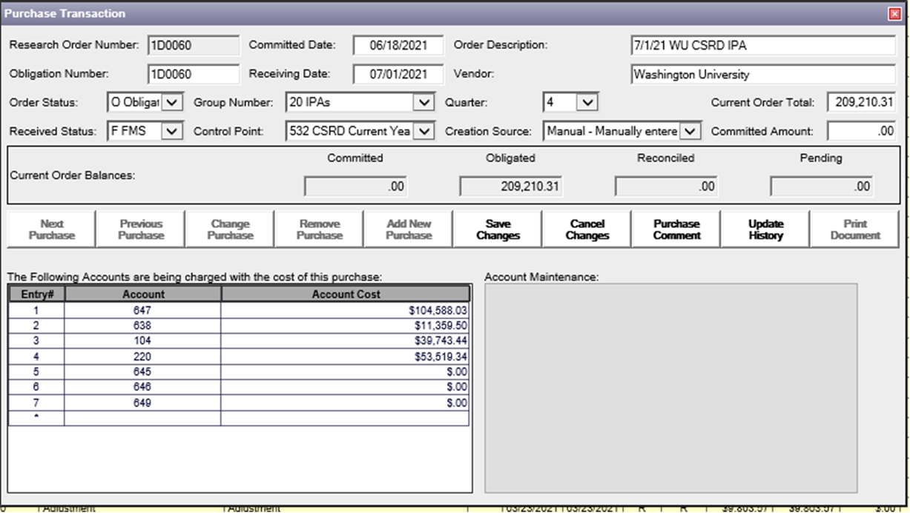
IPAs
Once you click on the “purchase” you will manually enter the accounts charge to information on this “purchase transaction” screen:
Notes:
I know that I’m up to 59 POs, so the next one will be 60. You can always go back and change the research order number as needed. You can also change this purchase in WinRMS anytime adjustments are needed.

Slide 17
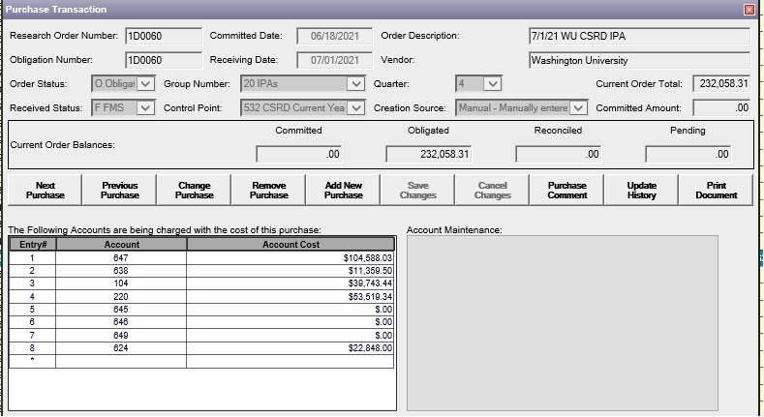
IPAs
Calculate the total amount needed for the PO for the period of performance and then distribute each PI/account IPAs in entry 1, 2, 3 and so forth. The sum of each entry must match the current order total.
In this example, I’m entering a single purchase order for all CSRD project IPAs at one affiliate.
The appeal of this approach is one purchase order to report on the UDO sheets, one PO for tracking and reconciling in VISTA and IPPS, and flexibility for the IPAs starting and ending during the PO period.
Notes:
Remember that your 1358s cannot exceed 12 months and they CAN cross fiscal years. Running IPAs 7/1 through 6/30 is helpful to reconcile timely before the end of the federal fiscal year.
Remember that UDO stuff from earlier training—those monthly reports are easier with fewer POs.

Slide 18
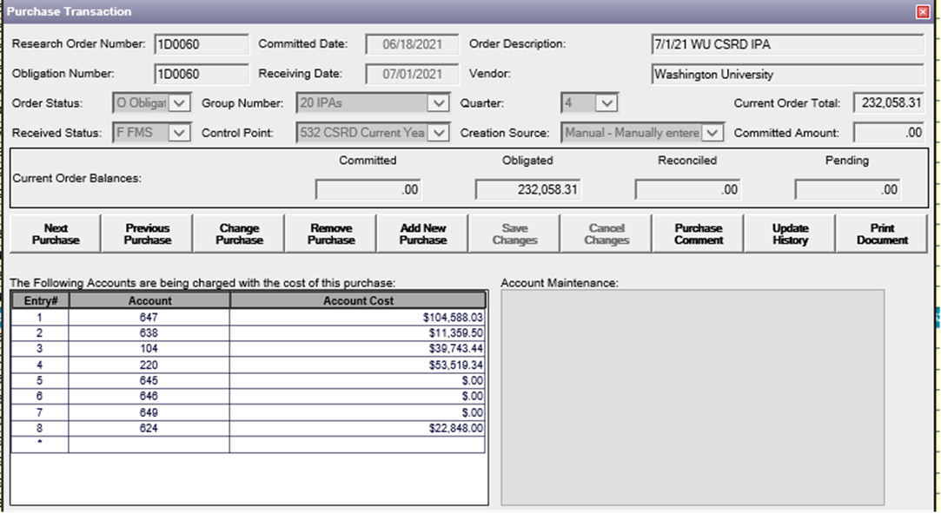
IPAs
WinRMS won’t allow the purchase distribution to save unless your entries add up and all of the fields pertaining to the purchase transaction are entered.
I’ve entered a zero for the IPAs pending so the purchase will show up on the PI’s account status display.
Increases and decreases to the order will be entered in VISTA and entered as a purchases and distributed in winRMS throughout the fiscal year.
Notes:
Couple notes on preference. I enter one line for all the PI’s IPAs. You could enter them separately so your PI can see more clearly who is costing what. This may be helpful if you’ll have significant movement or effort changes for personnel. When you review and certify monthly invoices in IPPS, the individual amounts paid out on the PO do not hit VISTA/RMS, you have to track. What WILL hit winRMS are the increases and decreases to the order. You

Slide 19
IPAs
Now take a look at the second fiscal year of the IPA purchase transaction and distribution in WinRMS.
In FY20 I obligated an IPA purchase order for CSRD IPAs at the affiliate spanning July 1, 2020- June 30, 2021.
Now it is Q1 FY21, and I have three more quarters of this purchase to track in WinRMS.
Recall the purchase order was created in FY20 Q3.
This means that July, August, and September are included in FY20, and now we are in FY21.
Helpful tool for planning is spreadsheet capturing FY cost distributions:

Slide 20
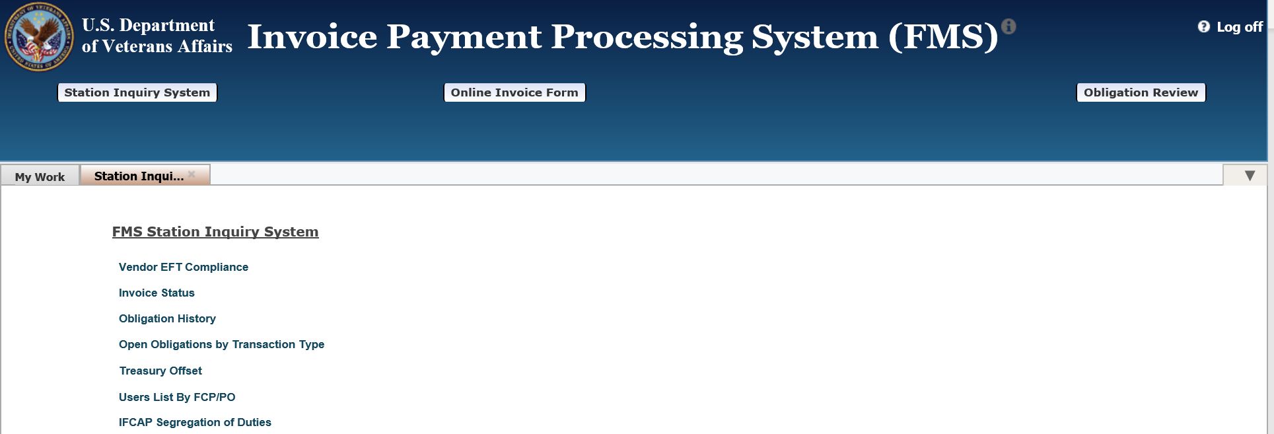
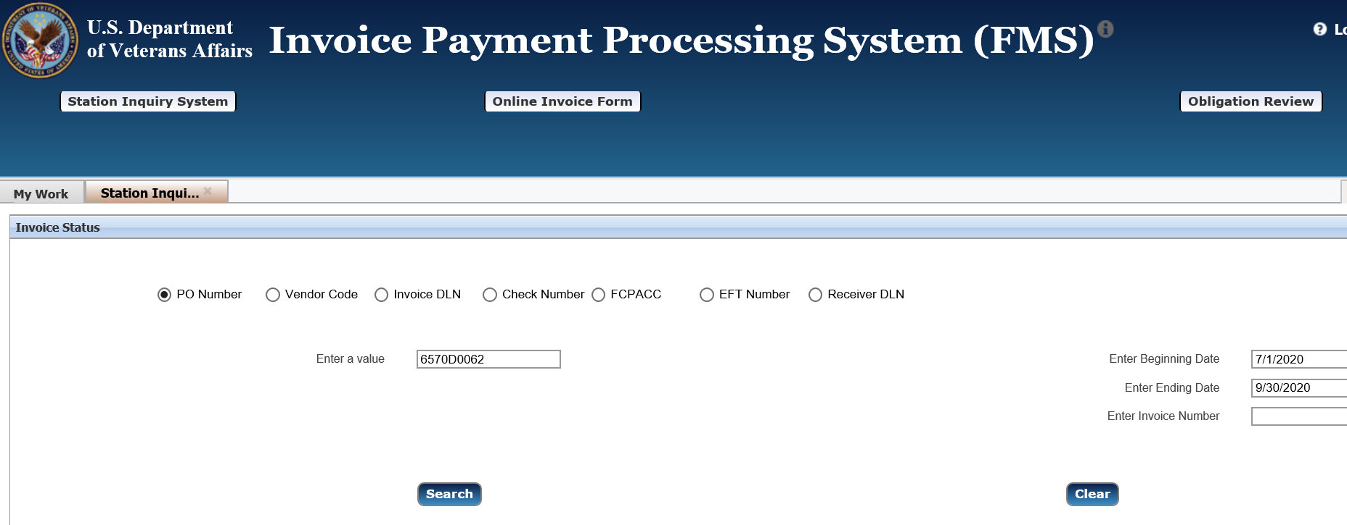
IPAs
Use IPPS as a tool to find what was actually invoiced and paid in the first quarter of the Purchase.
Run a report on the purchase order
Select: “Station Inquiry System”
“Invoice Status”
“PO Number”
Enter your dates.
Use this information as needed:
Affiliate follow up for invoicing
Deciding what to include in initial distribution
Notes:
“I plan and God laughs” but decide once what you’re going to include in your purchase.
Then create the purchase for the last three quarters of the fiscal year in the purchase transaction.

Slide 21
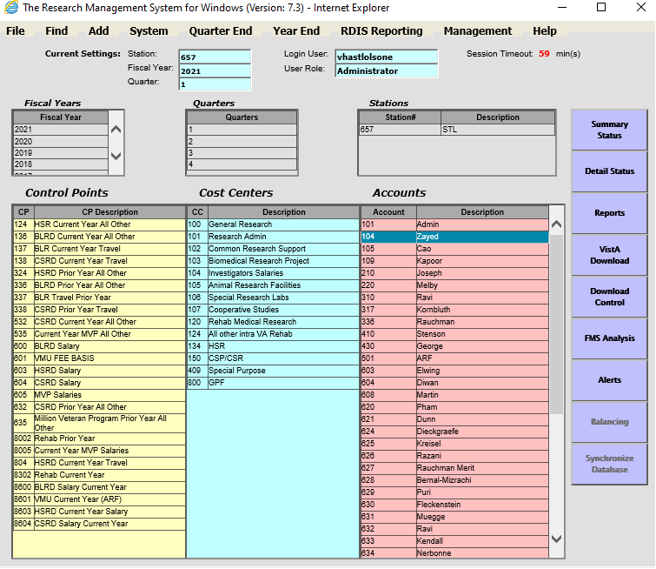
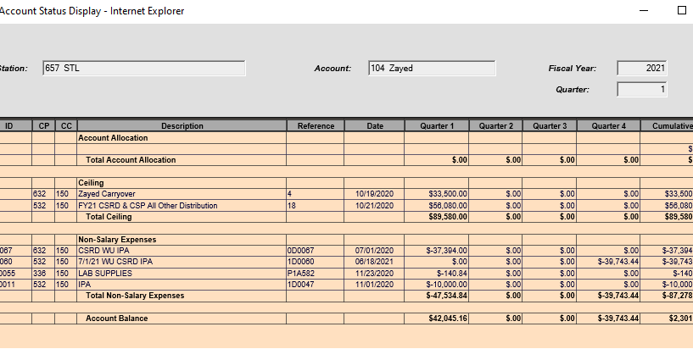
IPAs
PI account “detailed status” report
You can click on the purchase transaction from this WinRMS screen for adjustments to the purchase
Notes:
The fruits of your labor

Slide 22
Per Diems
If you house animals at the VA or at your affiliate, there are per diem charges that result from the housing of animals.
To account for these per diem charges in WinRMS, you will want to do an expense transfer.
For housing at the VA, an account is set-up for the animal facility and then an expense transfer is done from the animal facility account to the investigator account’s so that they are billed for the animal per diem expenses.
In Iowa City, we also house at our affiliate. We set-up a separate account for those transactions and complete an expense transfer.

Slide 23
Housing at VA
Each week I get a report from the Animal Facility of the per diem charges for each investigator that week.
The first time this occurs for the new fiscal year, I set-up a new expense transfer. This is done by going to Add -> Add Expense Transfer.

Slide 24
Housing at VA – New Expense Transfer
Select group number, FCP, and account the funds will be received in (animal facility)
Enter a detailed description so you know what time frame is being charged. Enter the total amount for the bill for that time period I n the Total Document Amount and Quarter.
Enter each Investigator account as a line item with their applicable per diem charges. You may choose to enter a description.

Slide 25
Housing at VA – Copy Expense Transfer
Once you have set-up a new expense transfer for the year, you do not need to create a new one each time you have per diem charges to enter.
You can select Find -> Find Expense Transfer and select the last expense transfer you entered for that item.
Click on it and then select Copy this Document.
This will copy all the items into a new document. You can edit each line item with the new amount and hit save changes. Don’t forget to also update the Document description to include the new dates!

Slide 26
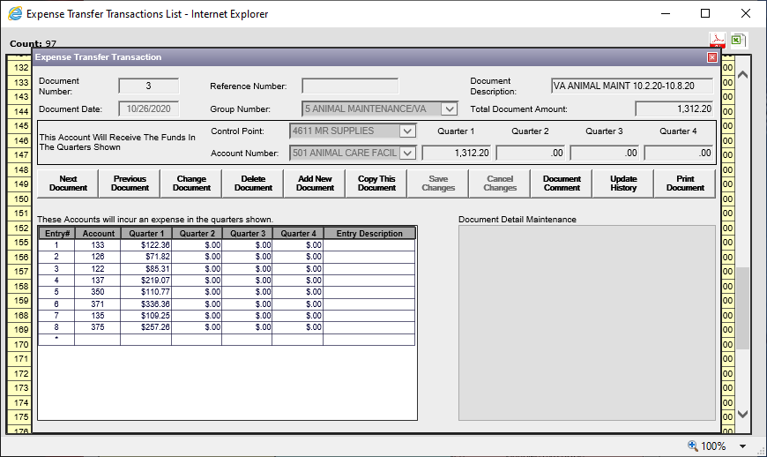
Housing at VA – Copy Expense Transfer

Slide 27
Affiliate Per Diem Charges
A contract is established with your affiliate for animal housing and care. The affiliate will then invoice you for the per diem charges through IPPS. In order to charge the investigator, you will want to create an expense transfer upon receipt of the invoice.
There are different ways to set-up the account for these charges. In Iowa City, we have created a Chargeback account. The initial contract goes into the Chargeback account and then we do an expense transfer to the Investigator account as the invoices come in. We are invoiced monthly.
The expense transfers are done the same way as the housing at the VA.

Slide 28
Affiliate Per Diem Charges
Monthly Expense Transfers to PI Accounts
Contract

Slide 29
Affiliate Per Diem Charges
In the example, the contract is done in one FCP (Biomedical). There are Rehab Investigators that house at the affiliate as well. In order to make sure the FCPs are appropriately charged, I request a cost transfer from the Biomedical FCP to the Rehab FCP for their per diem charges.
You may have separate PO numbers for each FCP. If that is the case, you don’t need to worry about this.

Slide 30
Core Facilities
If you have core facilities either at the VA or your affiliate, you will want to set-up expense transfers similar to the animal per diem charges.
You can create a Chargeback account for each Core Facility or create one for all of them.
For core facilities that are located at the VA, you will want to do an expense transfer similar to the animal housing at the VA.
For core facilities that are located at the affiliate, the process will also be similar to housing animals at the affiliate. There will be a contract in place and as you are invoiced for usage, you will do an expense transfer from the chargeback account to the PI account.

Slide 31
Core Facility (affiliate) Example
Core Facility Contract – RCB is our “Research Chargeback” account for Core Facilities

Slide 32
Core Facility (affiliate) Example

Slide 33
Conclusions
Setup accounts by Program
IPA management is strictly based on what local fiscal allows you to do
One to One or Many to One
Stay within the program
Use the expense transfer to manage within an FCP
General
Allocate to an FCP and Distribute to an account
Manage the Noise
Stay up to day and reconcile at least several times a week but definitely after payroll
Utilize VSSC, VISTA and other tools available to you
Call us if you need help or have questions

Slide 34
Final Polling Question – Part 1
How about, have the presentations made you reconsider how you use WinRMS
Yes
No
Still Not Clear

Slide 35
Final Polling Question – Part 2
Have these presentations clarified issues/concerns you may have had with WinRMS?
yes
no - need further guidance
no - did not have issues

Slide 36
Availability of Recording
A recording of this session and the associated handouts will be available on ORPP&E’s Education and Training website approximately one-week post-webinar
An archive of this and other webinars can be found here: https://www.research.va.gov/programs/orppe/education/webinars/archives.cfm

Slide 37
Questions??

